Slide 1
Noisy to Clear speech enhancement
Dataset: Wtimit
Epochs: 350
Noise: AWGN 2dB
Note: The following files have a sampling rate error but the model has given better results compared to 100 epochs
This is just to compare the spectrograms so the original audio files and the corresponding sentence that was spoken are not mentioned.

Slide 2
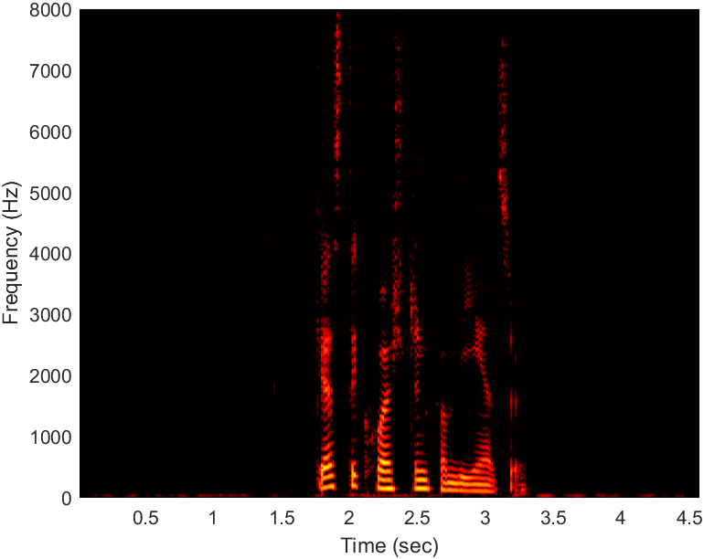
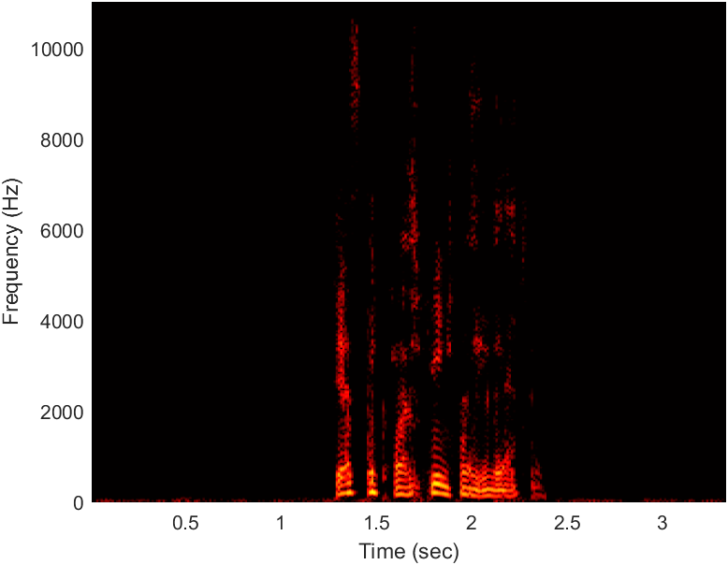
Sentence 1
Clean audio Converted audio

Slide 3
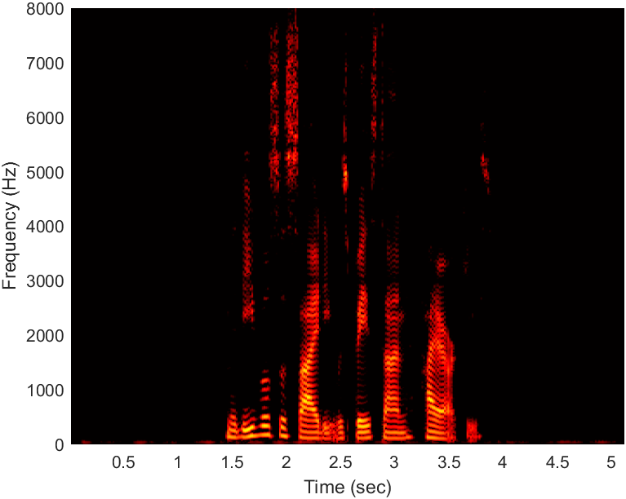
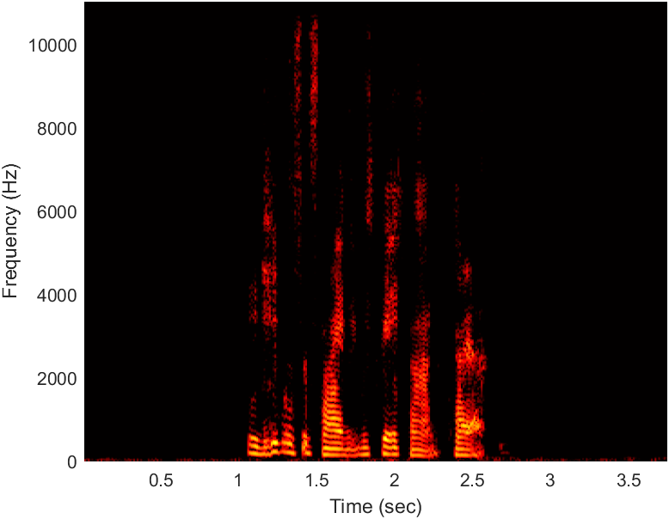
Sentence 2
Clean audio Converted audio

Slide 4
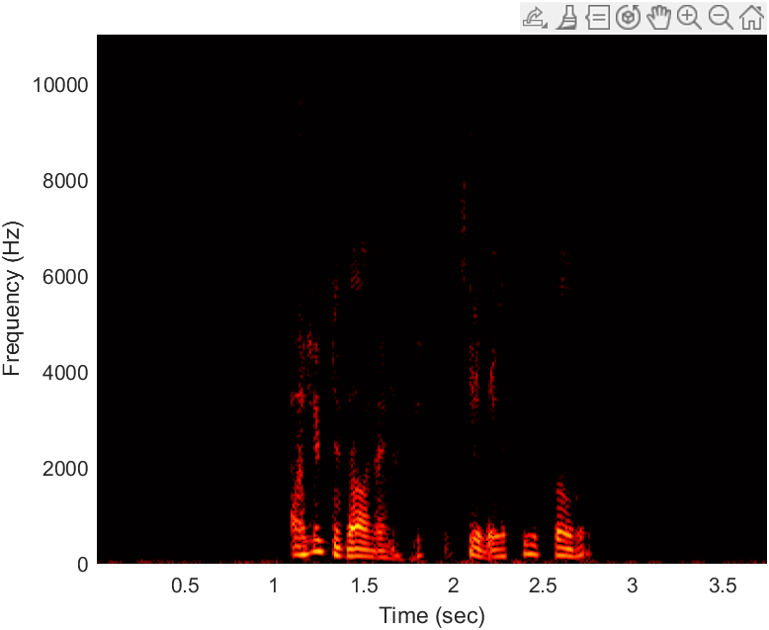
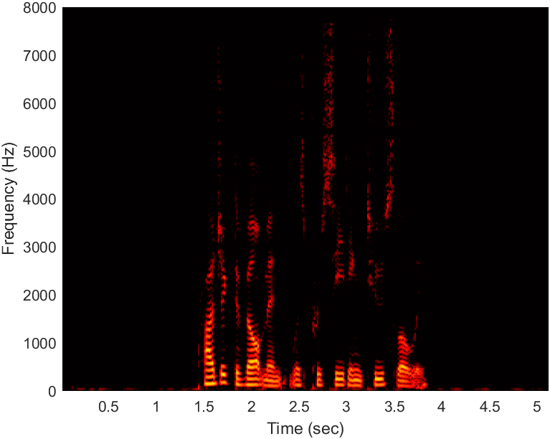
Sentence 3
Clean audio Converted Audio

Slide 5
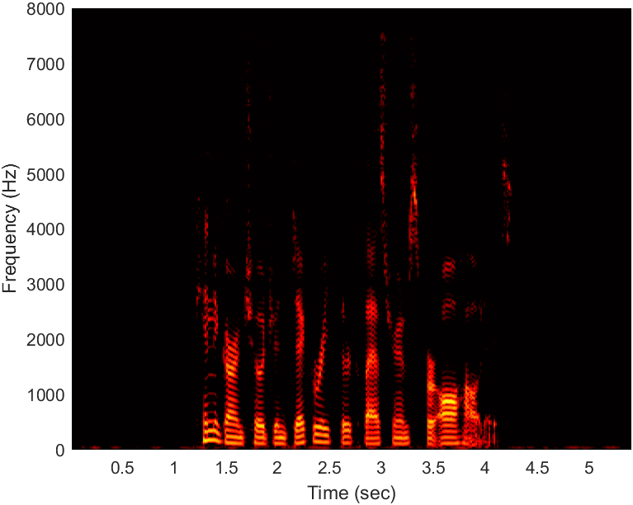
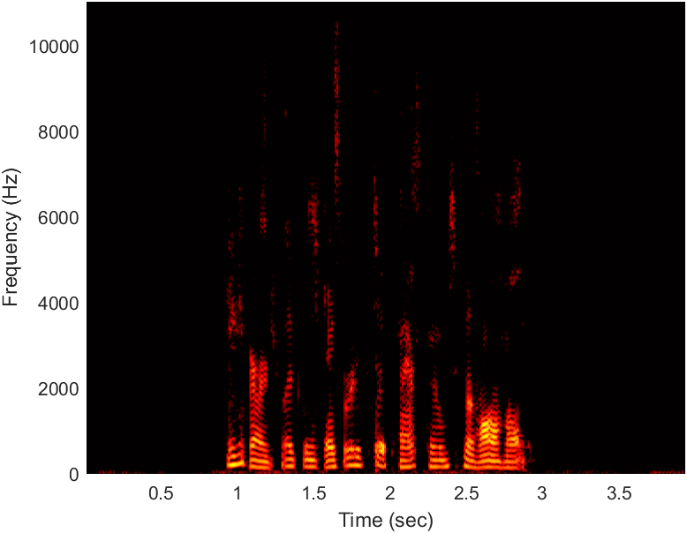
Sentence 4
Clean audio Converted audio

Slide 6
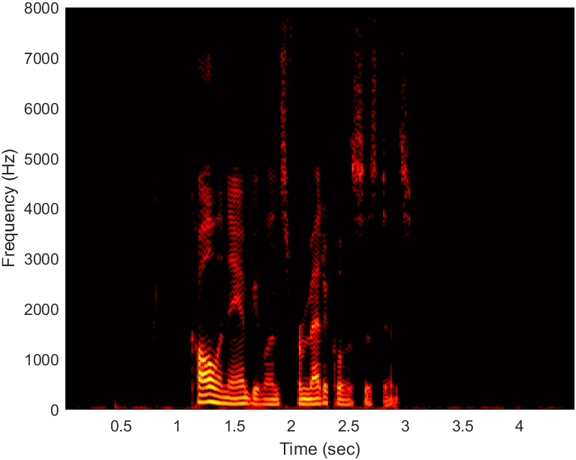
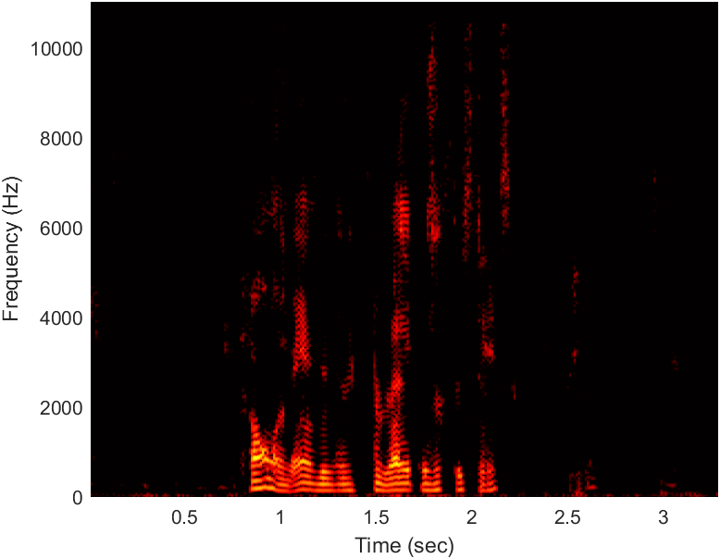
Sentence 5
Clean Audio Converted Audio

Slide 7
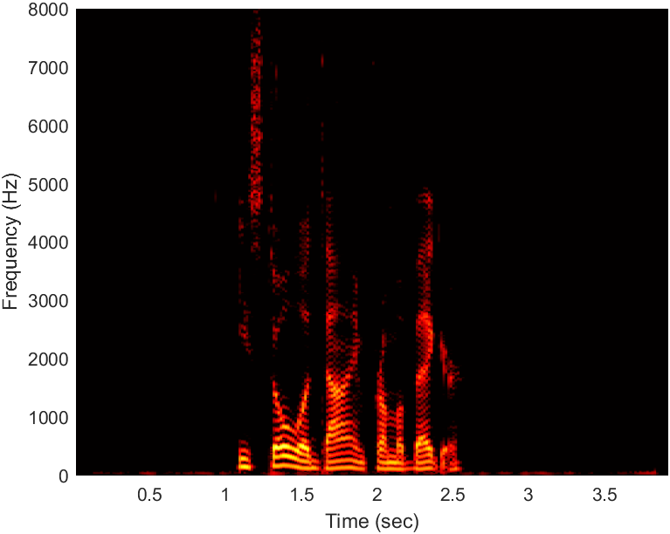
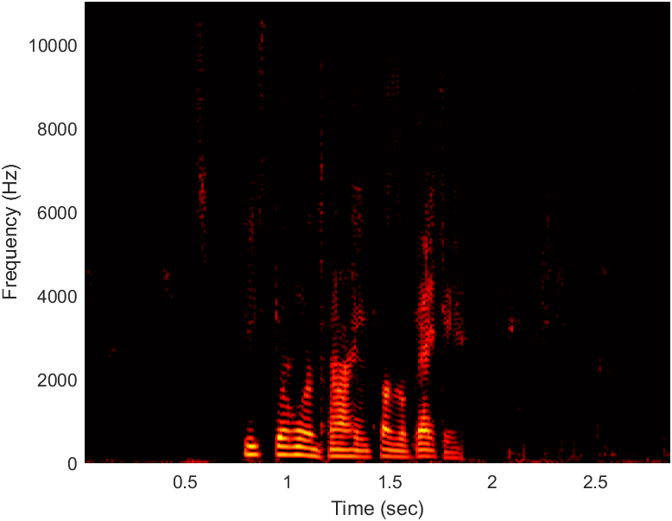
Sentence 6
Clean Audio Converted Audio

Slide 8
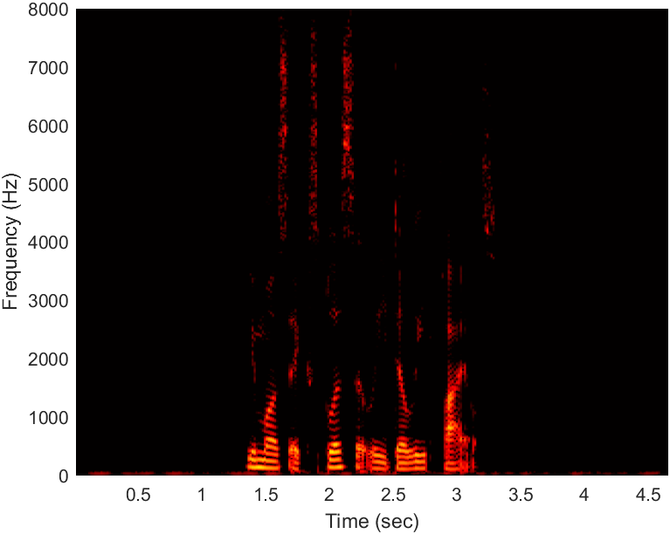
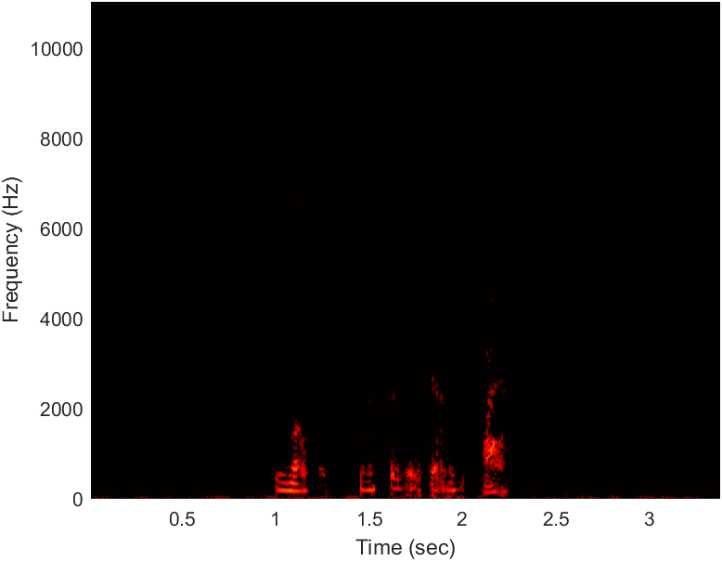
Sentence 7
Clean Audio Converted Audio

Slide 9
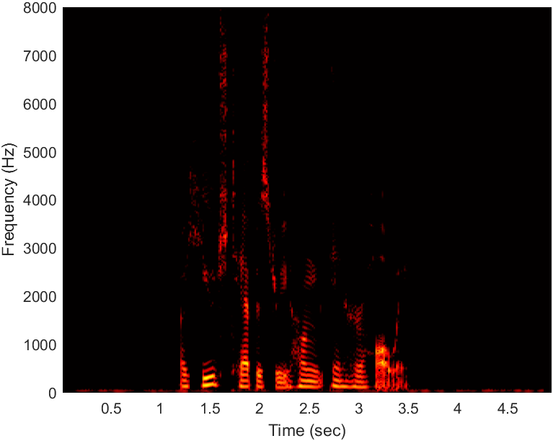
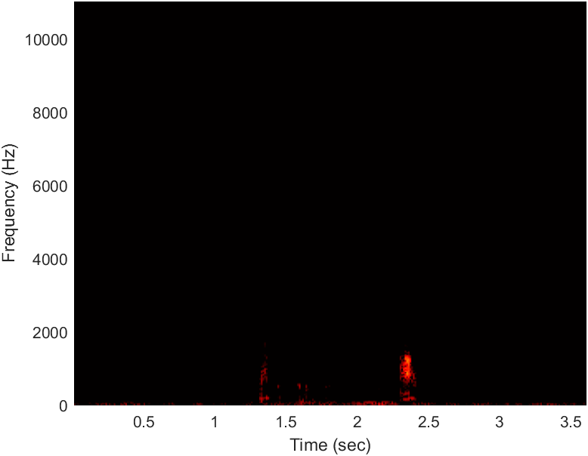
Sentence 8
Clean Audio Converted Audio

Slide 10
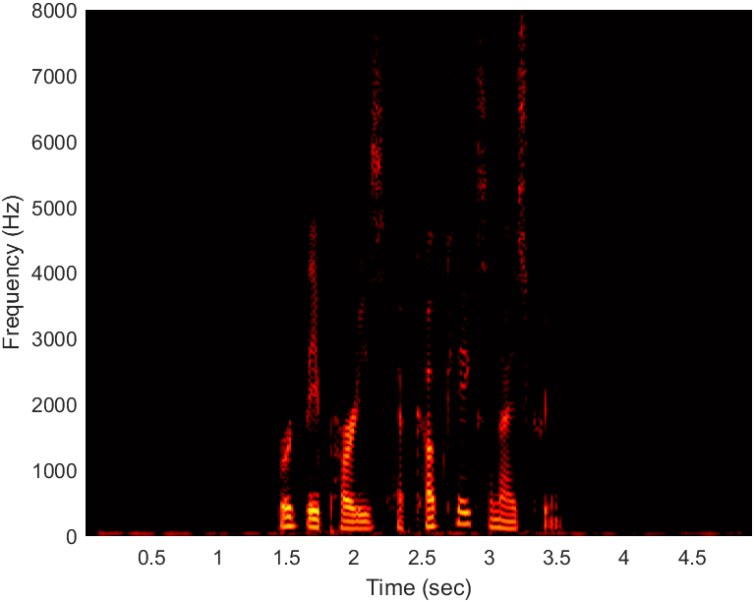
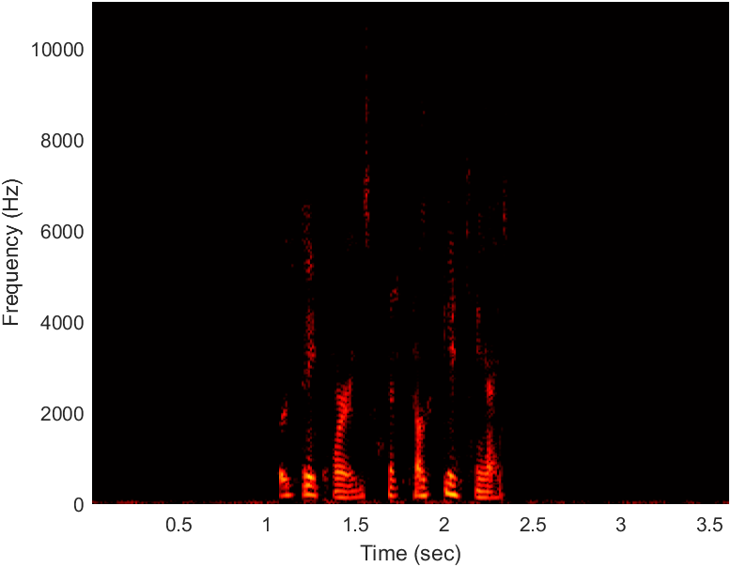
Sentence 9
Clean Audio Converted Audio

Slide 11
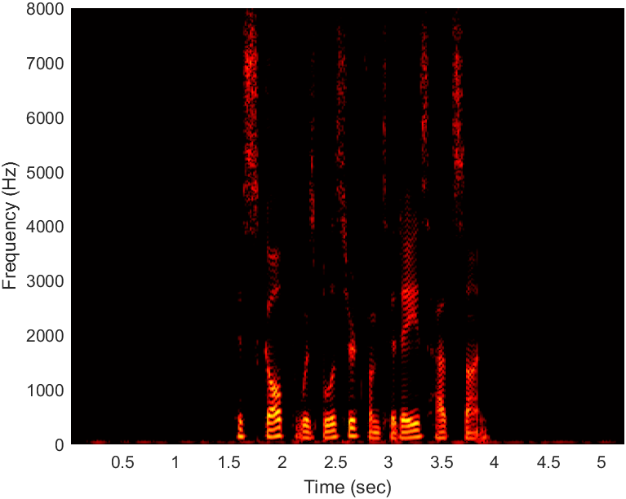

Sentence 10
Clean Audio Converted Audio

